Slide 1
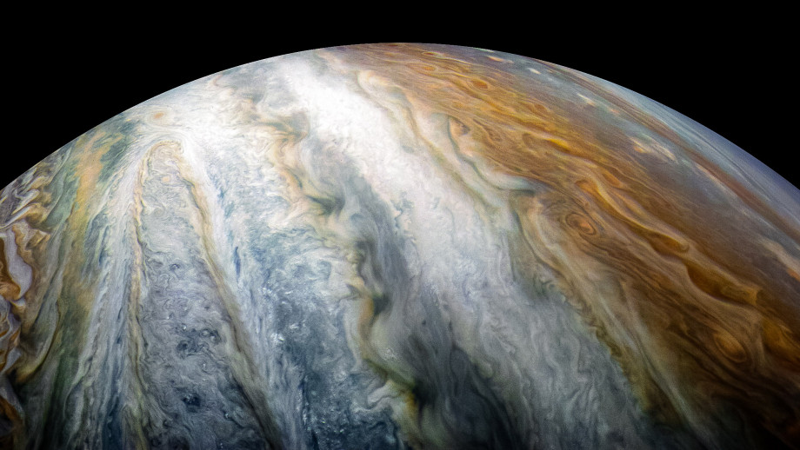
PowerShell in Notebooks

Slide 2

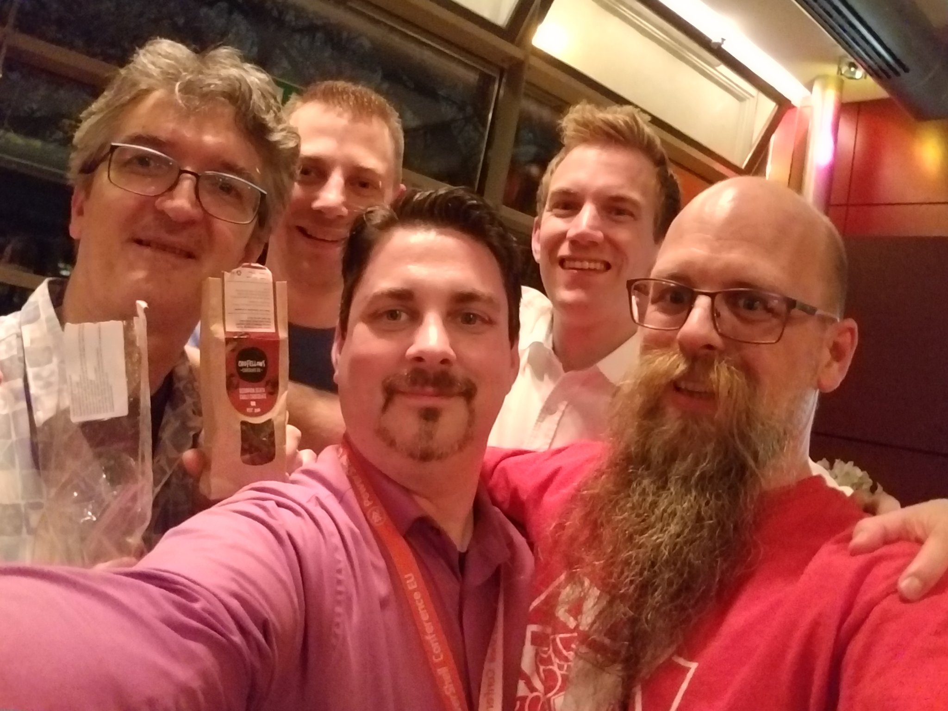
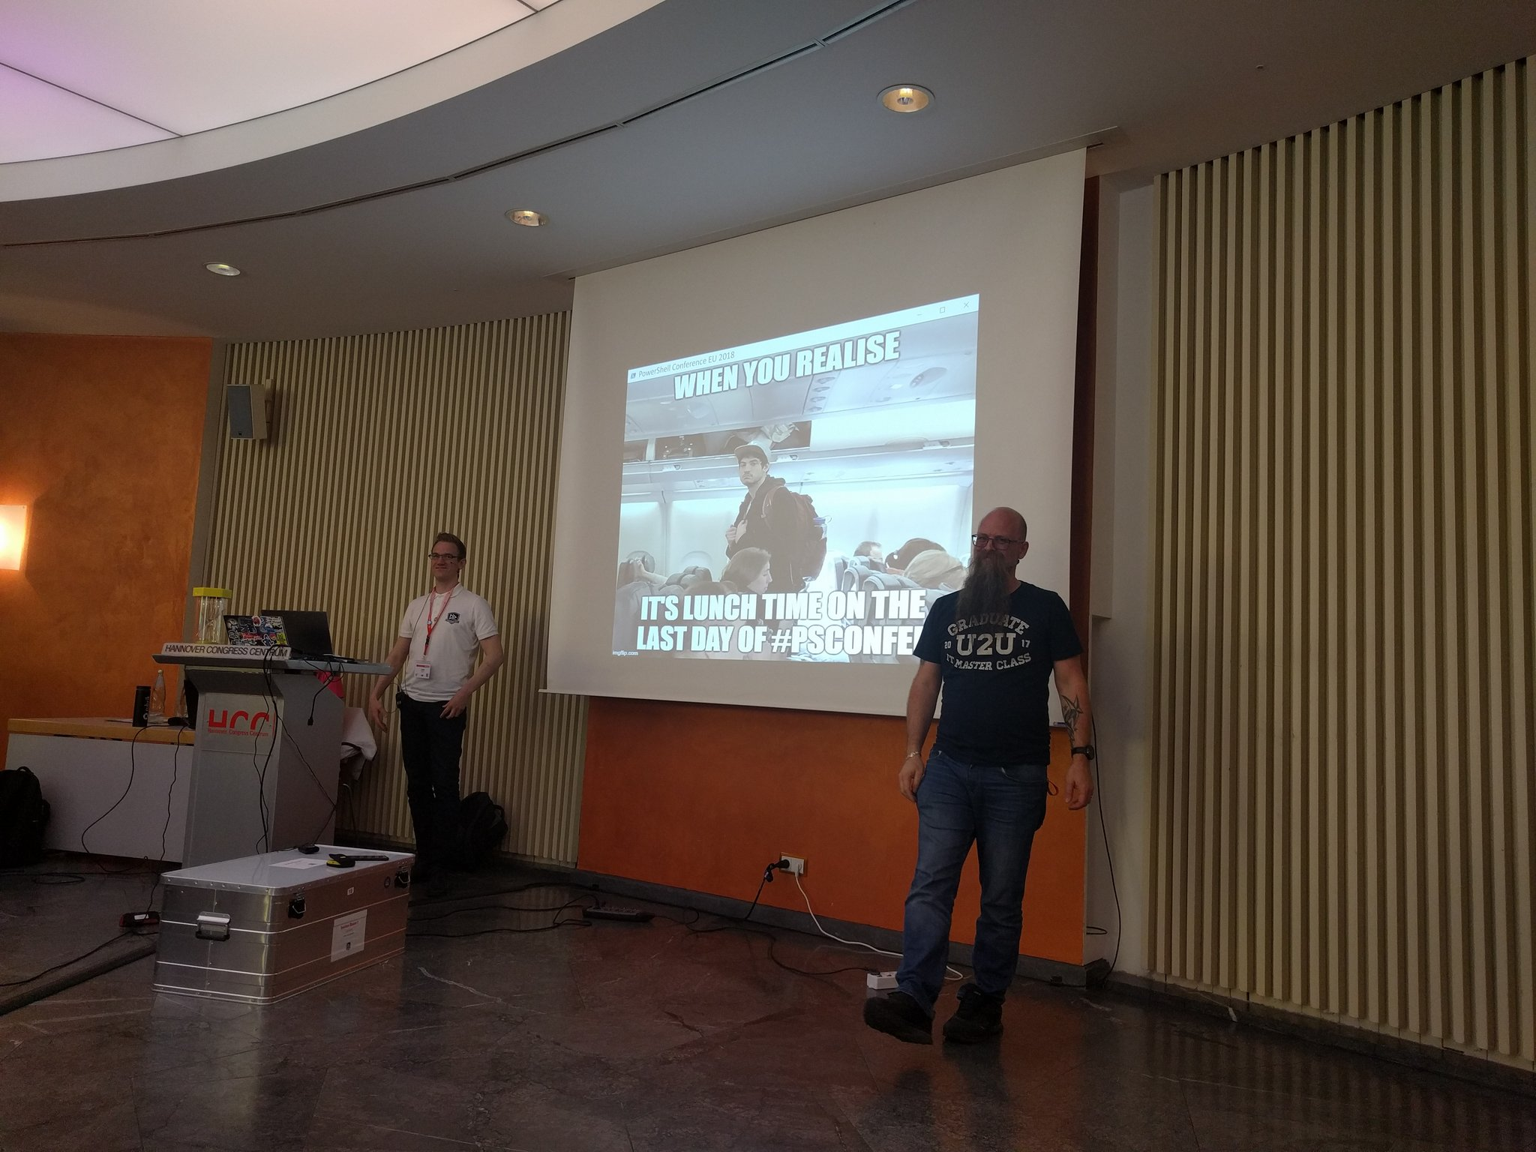

Slide 3

Rob Sewell
Bearded Consultant, Automator,
Trainer
Consultant Sewells Consulting Ltd
dbatoolsMoL dbachecks PowerShell & Data Community
beard.media\book
@sqldbawithbeard
SQLDBAWithABeard.com

Slide 4
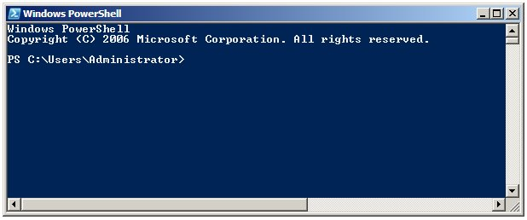
Running PowerShell
2006

Slide 5
Running PowerShell
2006

Slide 6
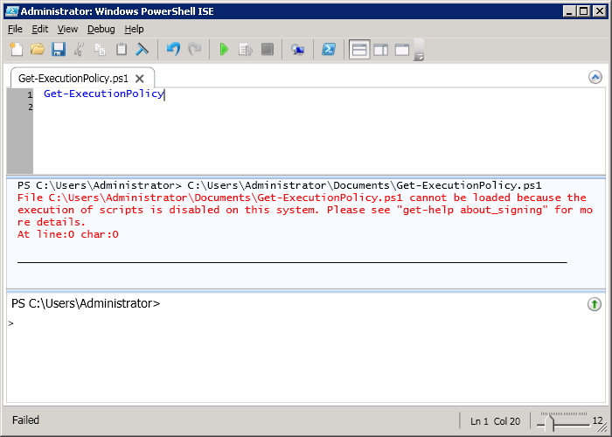
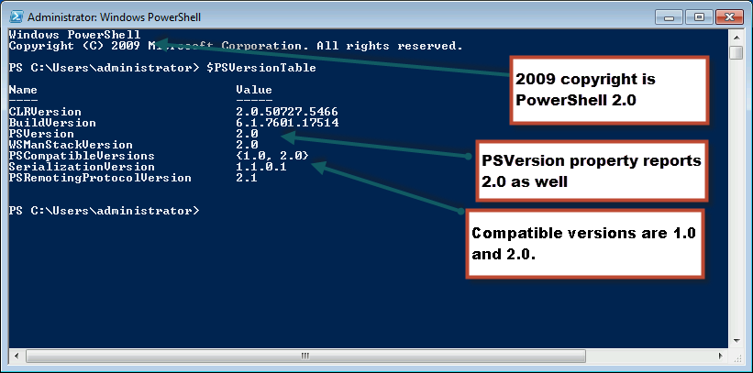
Running PowerShell
2010

Slide 7
Running PowerShell
2010

Slide 8
Running PowerShell
2010

Slide 9
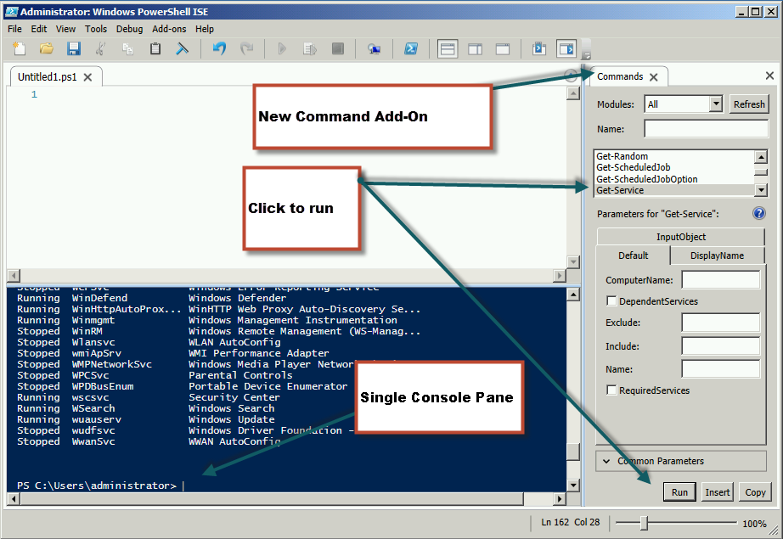
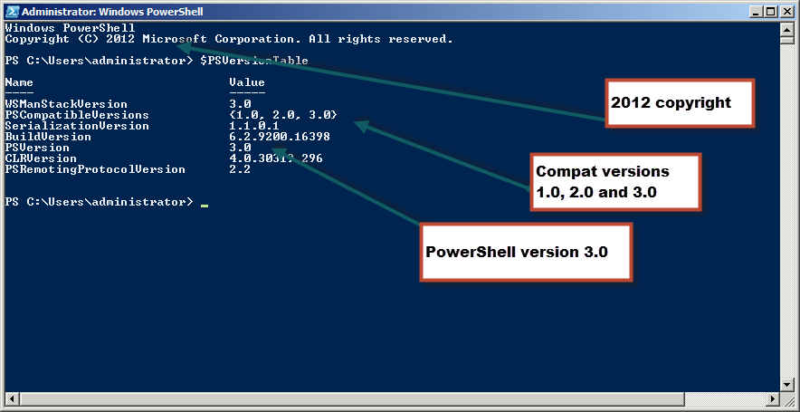
Running PowerShell
2012

Slide 10
Running PowerShell
2012

Slide 11
Running PowerShell
2012

Slide 12
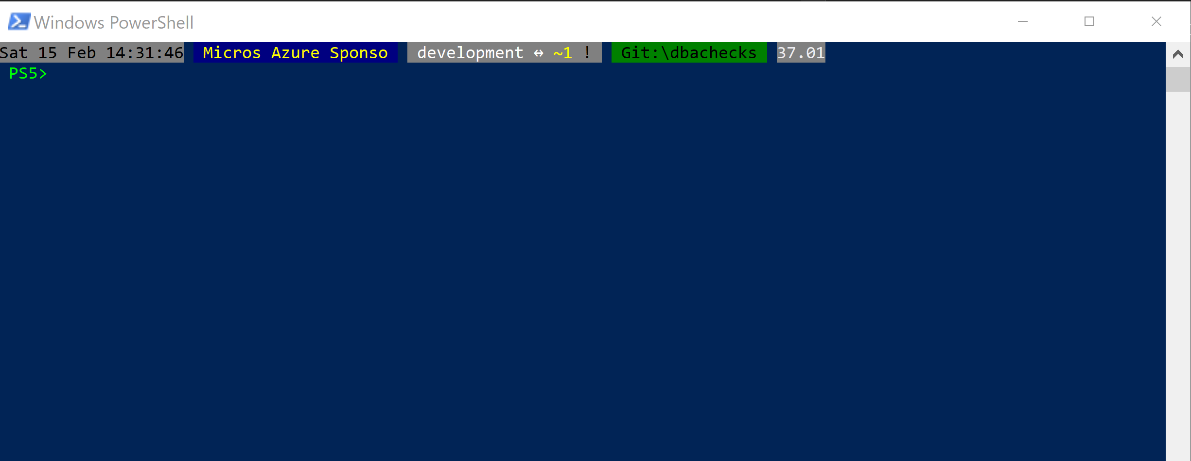
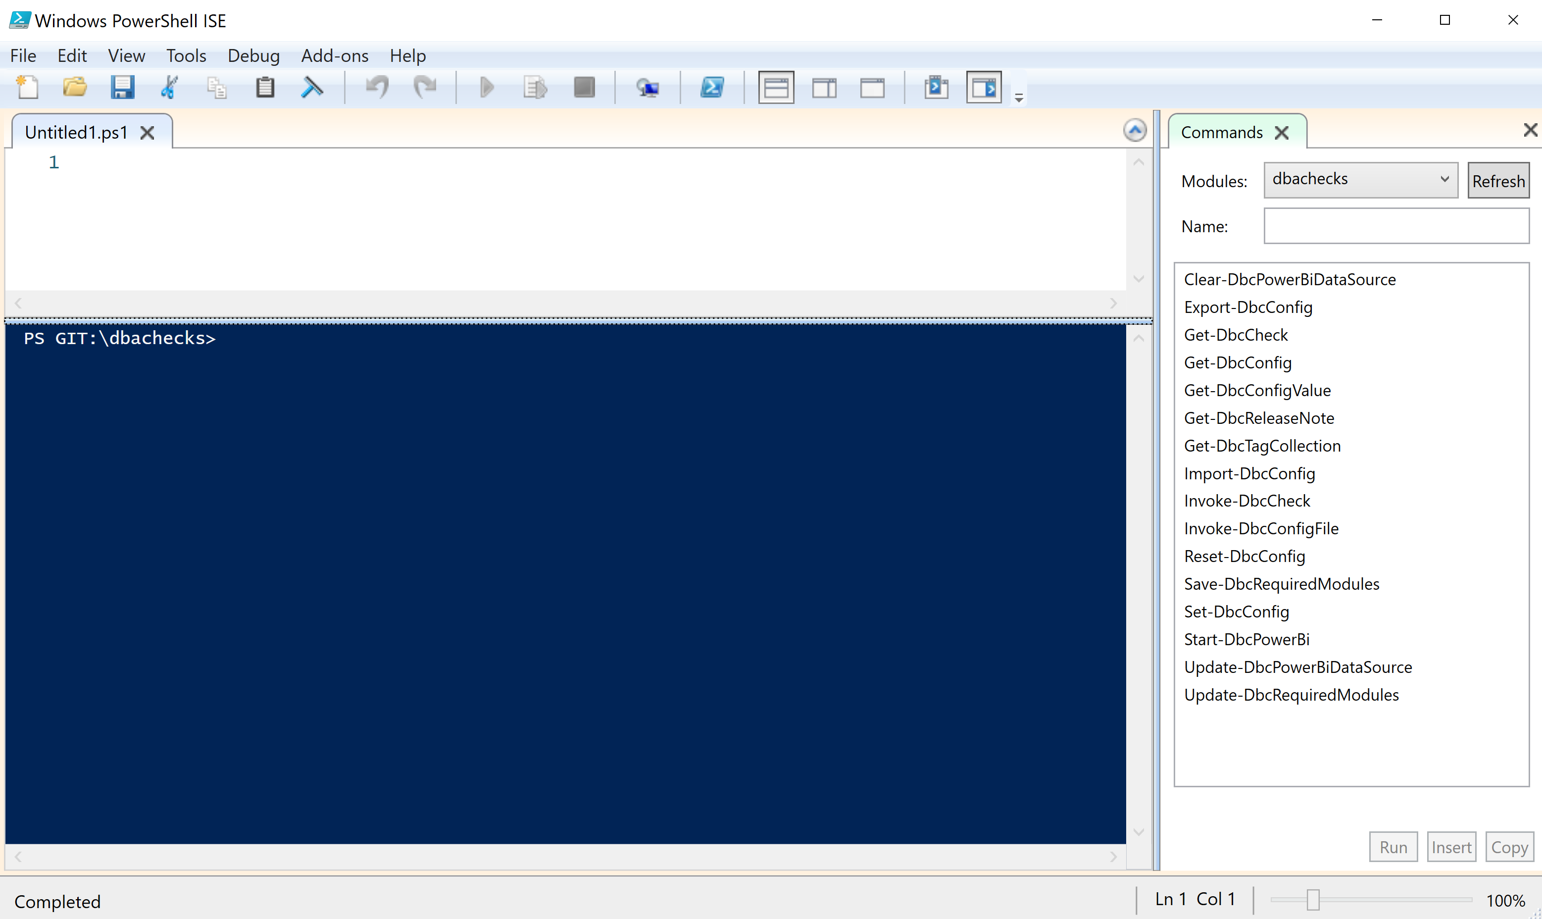
Running PowerShell
2017

Slide 13
Running PowerShell
2017

Slide 14
Running PowerShell
2017

Slide 15
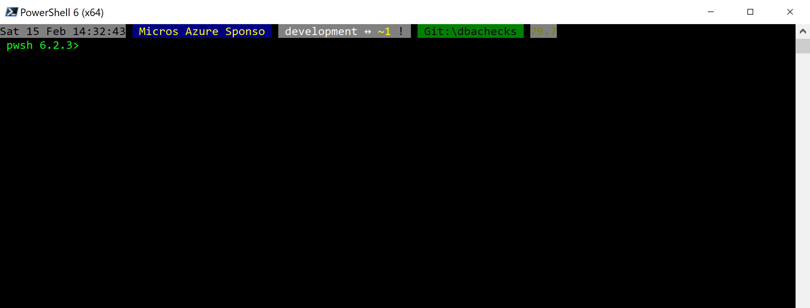
Running PowerShell
2018

Slide 16
Running PowerShell
2018

Slide 17
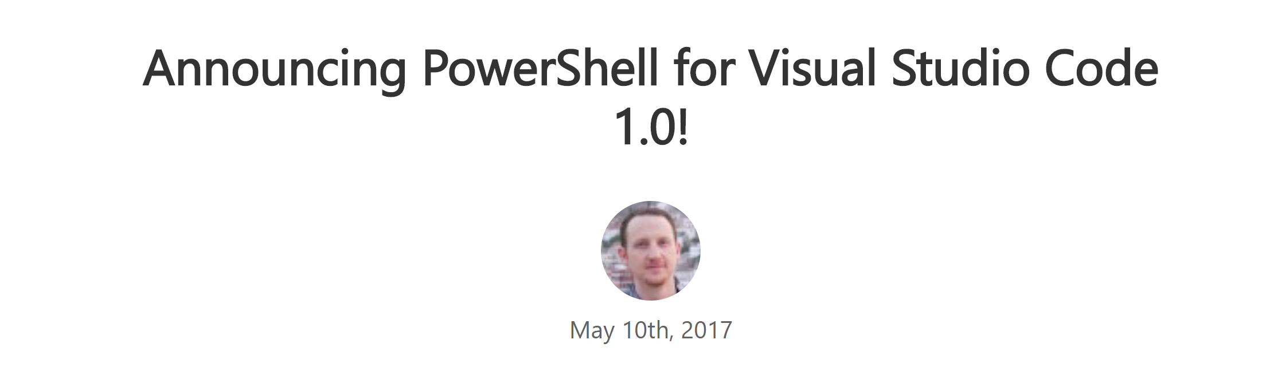
Running PowerShell
2016-17

Slide 18
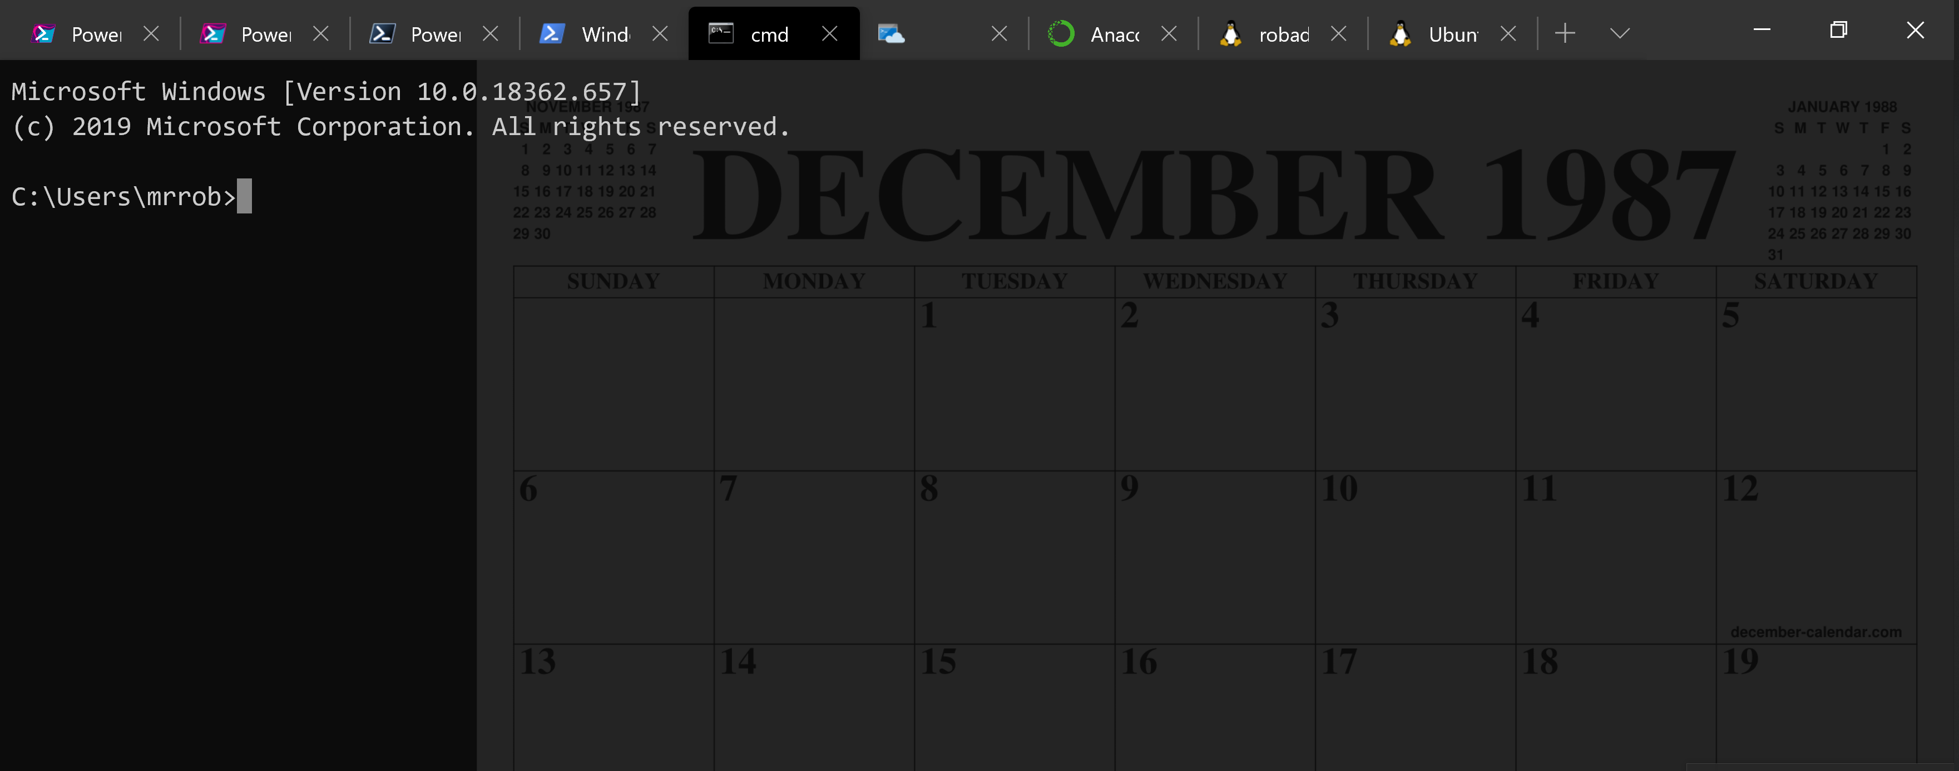
Running PowerShell
2016-17

Slide 19
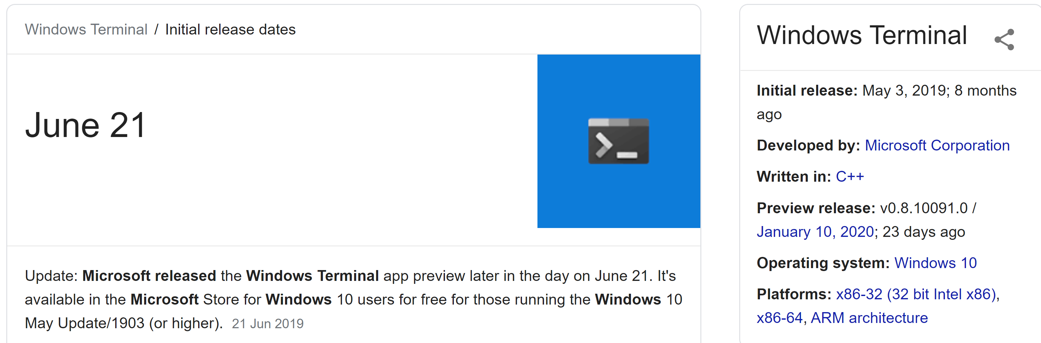
Running PowerShell
2019

Slide 20
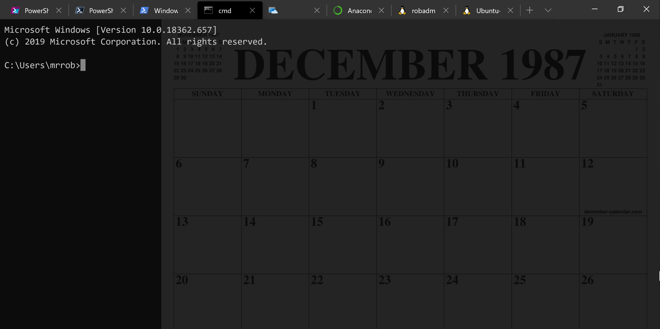
Running PowerShell
2019

Slide 21
Running PowerShell
2019

Slide 22
A Decade and a Half

Slide 23
Uh, Houston, we've had a problem
https://en.wikipedia.org/wiki/Houston,_we_have_a_problem

Slide 24
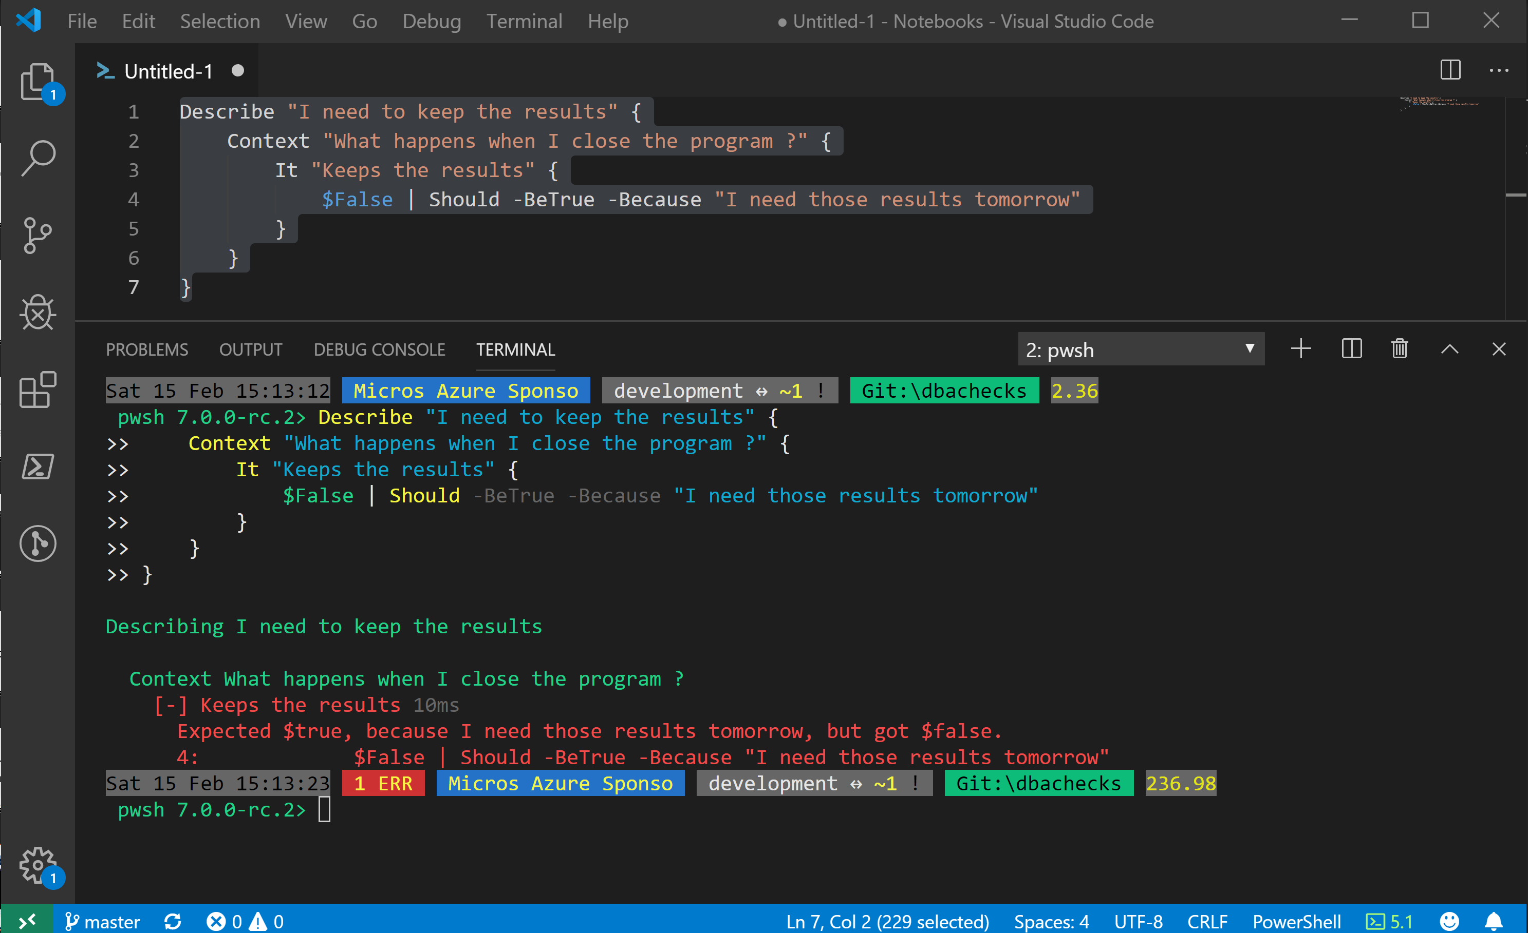
Without some effort………..

Slide 25
Without some effort………..

Slide 26
Without some effort………..

Slide 31
ALL
GONE

Slide 32
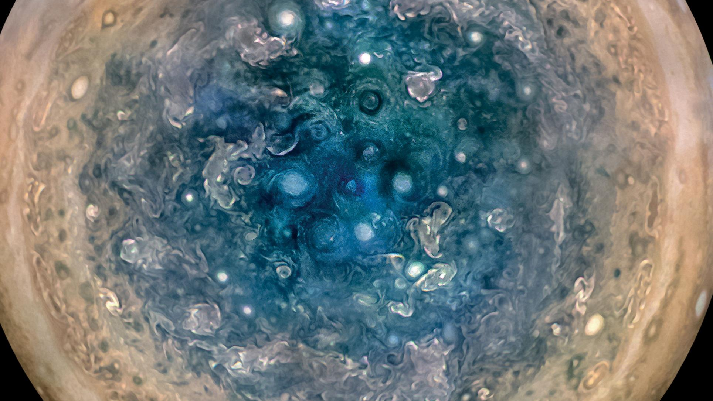

Slide 33
First, the names comes from the planet Jupiter. We wanted to pick a name that evoked the traditions and ideas of science.
Jupyter
@SQLDBAWithBeard SqlDbaWithABeard.com Rob Sewell beard.media/book

Slide 34
Jupyter
First, the names comes from the planet Jupiter. We wanted to pick a name that evoked the traditions and ideas of science.
Second, the core programming languages supported by Jupyter are Julia, Python and R. While the name Jupyter is not a direct acronym for these languages, it nods its head in those directions. In particular, the "y" in the middle of Jupyter was chosen to honor our Python heritage. See the logos of these languages in the languages folder of this repo.
https://github.com/jupyter/design/wiki/Jupyter-Logo
@SQLDBAWithBeard SqlDbaWithABeard.com Rob Sewell beard.media/book

Slide 35
Jupyter
Second, the core programming languages supported by Jupyter are
Julia, Python and R.
While the name Jupyter is not a direct acronym for these languages, it nods its head in those directions.
In particular, the "y" in the middle of Jupyter was chosen to honor our Python heritage.
Third, Galileo was the first person to discover the moons of Jupiter. His publication on the moons of Jupiter is an early example of research that includes the underlying data in the publication. This is one of the core ideas and requirements for scientific reproducibility. Reproducibility is one of the main focuses of our project.
https://github.com/jupyter/design/wiki/Jupyter-Logo
@SQLDBAWithBeard SqlDbaWithABeard.com Rob Sewell beard.media/book

Slide 36
Jupyter
Third, Galileo was the first person to discover the moons of Jupiter. His publication on the moons of Jupiter is an early example of research that includes the underlying data in the publication.
This is one of the core ideas and requirements for scientific reproducibility. Reproducibility is one of the main focuses of our project.
https://github.com/jupyter/design/wiki/Jupyter-Logo
@SQLDBAWithBeard SqlDbaWithABeard.com Rob Sewell beard.media/book

Slide 37

What is a Jupyter Notebook?
Originally for Data Scientists

Slide 38
What is a Jupyter Notebook?
Document that can contain text, code, images and query results
@SQLDBAWithBeard SqlDbaWithABeard.com Rob Sewell beard.media/book

Slide 39
What is a Jupyter Notebook?
Document that can contain text, code, images and query results
@SQLDBAWithBeard SqlDbaWithABeard.com Rob Sewell beard.media/book

Slide 40
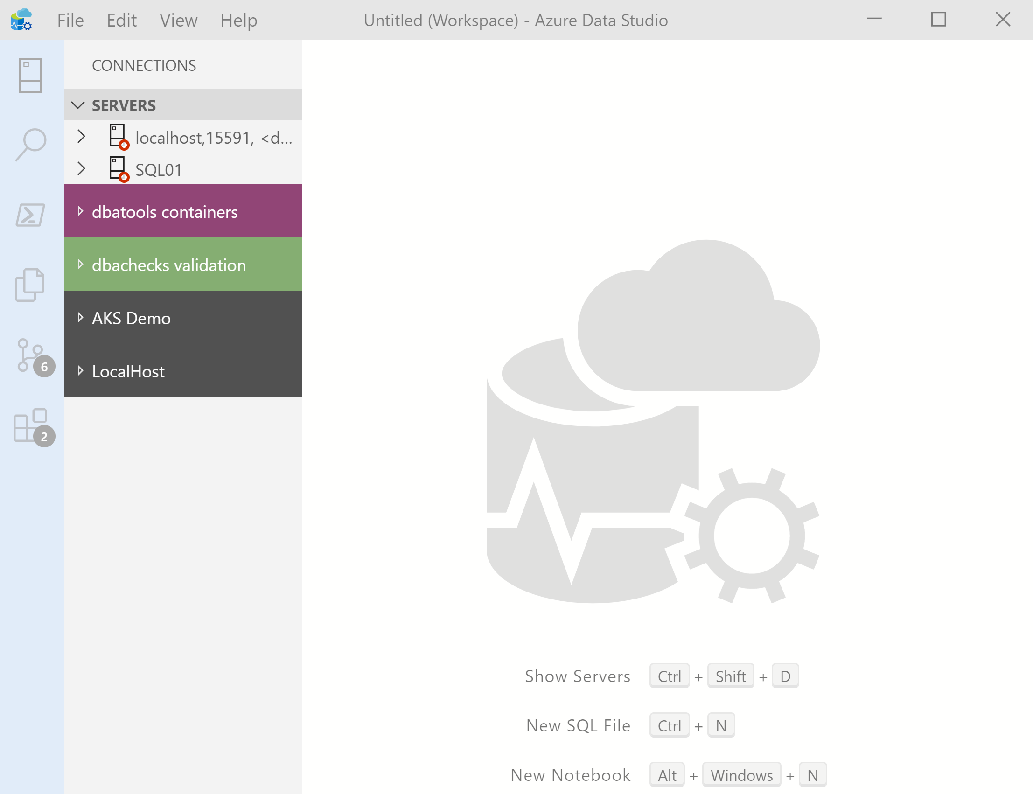

What’s Azure Data Studio ?
Cross Platform desktop environment for Data Professionals
@SQLDBAWithBeard SqlDbaWithABeard.com Rob Sewell beard.media/book

Slide 41
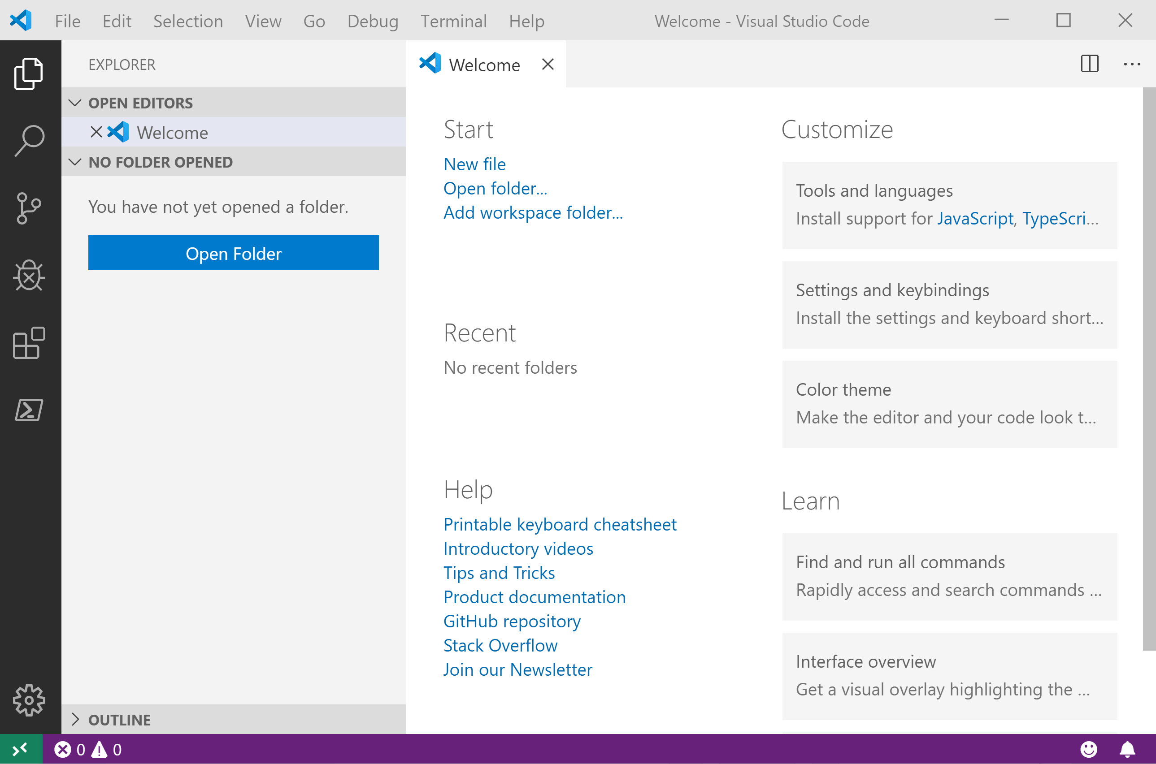
It Looks Like Visual Studio Code ?
@SQLDBAWithBeard SqlDbaWithABeard.com Rob Sewell beard.media/book

Slide 42
It Looks Like Visual Studio Code ?
@SQLDBAWithBeard SqlDbaWithABeard.com Rob Sewell beard.media/book

Slide 43
.NET Interactive Notebooks
Announced at Ignite but preview announced with PowerShell February 6th 2020 https://devblogs.microsoft.com/dotnet/net-interactive-is-here-net-notebooks-preview-2/
@SQLDBAWithBeard SqlDbaWithABeard.com Rob Sewell beard.media/book

Slide 44
.NET Interactive Notebooks
All the goodness of Jupyter Notebooks with added
PowerShell (and C#) (and F#)
@SQLDBAWithBeard SqlDbaWithABeard.com Rob Sewell beard.media/book

Slide 45
Enough talk
Lets see it!
beard.media\book
@sqldbawithbeard
SQLDBAWithABeard.com
@SQLDBAWithBeard SqlDbaWithABeard.com Rob Sewell beard.media/book

